Slide 1

LOD4DataONE
Summer internship
Aída Gándara
Understanding the use cases

Slide 2

Initial Goals for LOD
Understanding the DataONE data
Understanding what to share
Understanding how to share it

Slide 3

DataONE Data
Considered 3 data repositories
Dryad repository for publishing data about publications
KNB repository for publishing metadata about data
ORNL DAAC repository for publishing metadata about data - seem to be using individualized curation

Slide 4

Dryad Data Repository
dryad.82 about
doi:10.1098/rspb.2007.0505
dryad.83
PriceGittleman_2007_append
.xls
HTTP server
OAI-PMH Web services

Slide 5

Dryad Data Access
HTTP Web Browser - manually
Open dryad.82, see relationship to dryad.83, can open link
Open dryad.83, see relationship to xls file, can open link
Request to see metadata of the files
OAI-PMH Web services - programmatically
Get dryad.82, Get dryad.83
Request the data in Dublin-Core XML format
Parse the data and pull out information
Get data file bitstream from Mets.
Extract data dependent on format and extraction tools
See wiki for more examples: https://www.nescent.org/wg_dryad/DataAccess

Slide 6

KNB Data Relationships & Access
connolly.116.10
connolly.106.1
connolly.104.1
connolly.102.1
connolly.105.1
AppendixC-1.txt
Micro…jpg
AppendixE.txt
AppendixD-1.txt
HTTP server
Metacat Interface

Slide 7

KNB Data Access
HTTP Web Browser - manually
Search for connolly.116.10 on KNB website
View metadata (EML)
Open views to other files and their metadata – 105.1, 104.1, 102.1, 106.1
Use Metacat API - programmatically
Request connolly.116.10 metadata from Metacat connection
Returns metadata for files (dataTables) as well in EML
Open data files for each datatable as a byte inputstream
Extract data dependent on format and extraction tools
KNB also has OAI-PMH interface supplied by Dryad

Slide 8

ORNL DAAC
directory
data
metadata
HTTP Web Server
ftp
OAI-PMH Web services

Slide 9
ORNL DAAC Data Access
HTTP Web Browser – manually
Interactive tools for searching for data
Can select and download data
FTP downloads – programmatically
Still working on this, less programmer friendly environment
KNB also has OAI-PMH interface

Slide 10
Exposing as RDF
Focused more on metadata because of concerns for data misuse
For Dryad was able to leverage Dublin Core terms returned through OAI-PMH interface
KNB was able to leverage EML XML that was returned through the Metacat interface

Slide 11
Dryad to RDF
RDF | Constructs Used | Observations
Types | DCType, DatafileType | Expanded DCMIType with more file terminology
Properties | hasPart, isPartOf, seeAlso | Made them explicit in the RDF, the xml from Dryad only used dc:relation
Links | rdf:resource (FOAF, DBPedia, CreativeCommons) | Links to RDF things
All others dc: terms | rdf:datatype | All entities have a type
data | Species | Pulled out some search data from the Gittleman xls file

Slide 12
KNB to RDF
RDF | Constructs Used | Observations
Types | SpatialThing, datafile | datafile expanded DCMIType with more file terminology. SpatialThing used to specific location
Properties | hasPart, isPartOf, seeAlso | Made these explicit in the RDF from dataTable statements in EML
Links | rdf:resource (FOAF, DBPedia, CreativeCommons) | Links to RDF things
All others dc: terms | rdf:datatype | All entities have a type
data | none | These datasets had the best properties in eml, e.g. time and location

Slide 13
LOD4DataONE Use Case 1
User Queries Data
LOD Cloud Data Server Resolves URIs to RDF content
(Not expected to be a single server. Could be any server on the LOD Cloud)
Browser displays RDF data in context
User selects a link (URI)
Browser displays RDF data in context
See: http://notebooks.dataone.org/LOD4DataONE/use-cases/

Slide 14
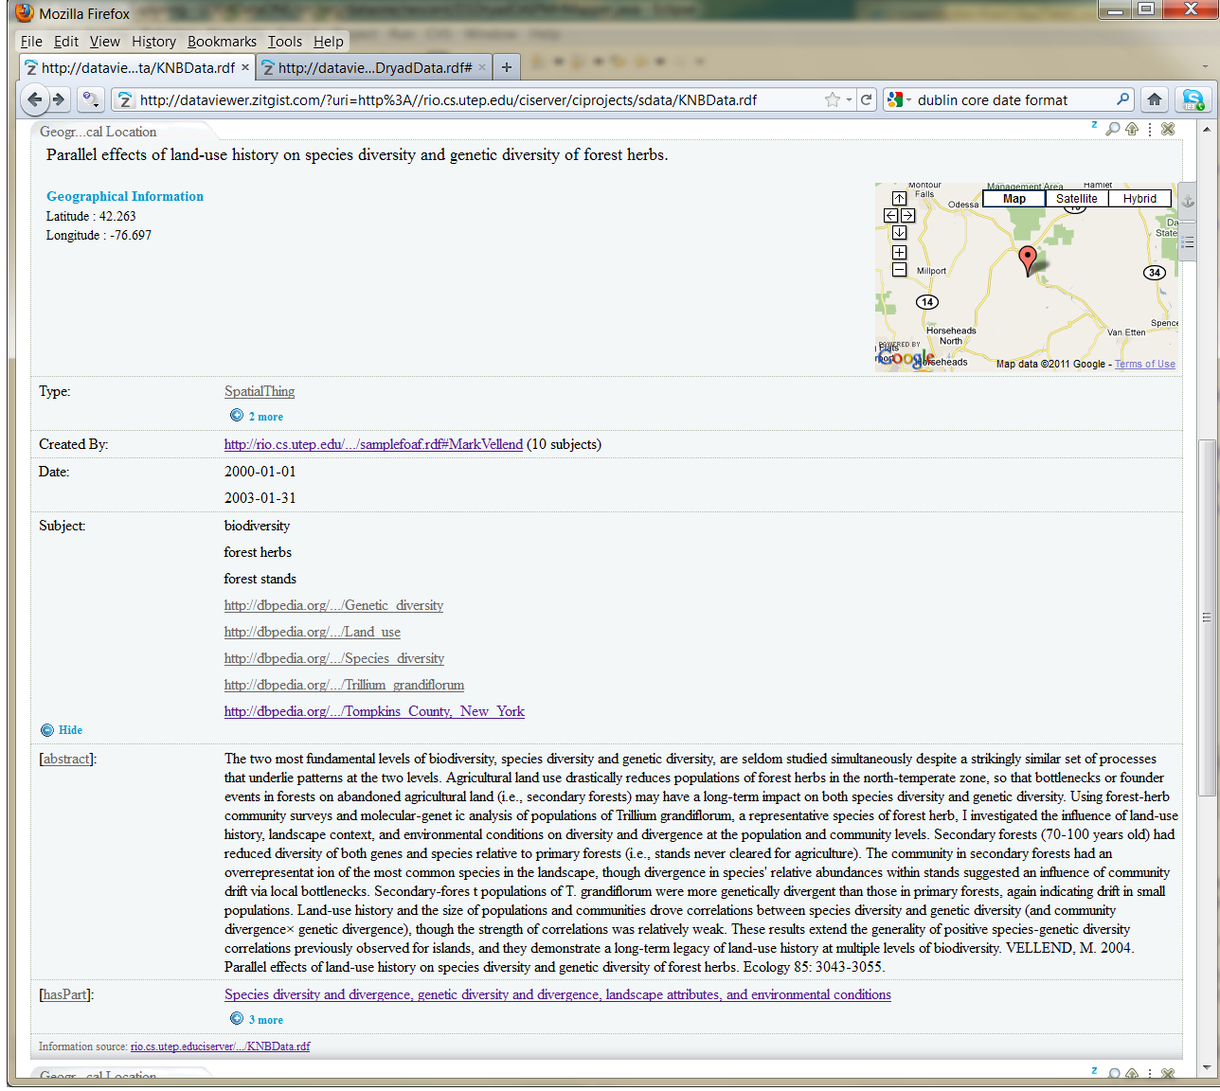
E
X
A
M
P
L
E
O
N
Z
I
T
G
I
S
T
1) LOADED MY INITIAL DATA : KNB RDF
2) VIEW SOME CONTEXT : Geo Data
3) LINKS TO RELATED THINGS: e.g., FOAF for author, DBPedia information, what this is made up of hasPart
FOAF
DBPedia

Slide 15
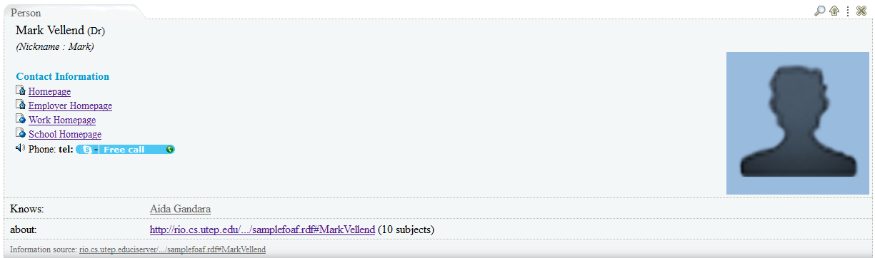

EXAMPLE IN ZITGIST : Template for FOAF data
This template extracts what it knows from the FOAF vocabulary to organize a view of the data
ZITGIST will continue to load and provide ‘useful’ views as long as it understands the vocabulary. This is why working together to create and integrate useful views is important.

Slide 16
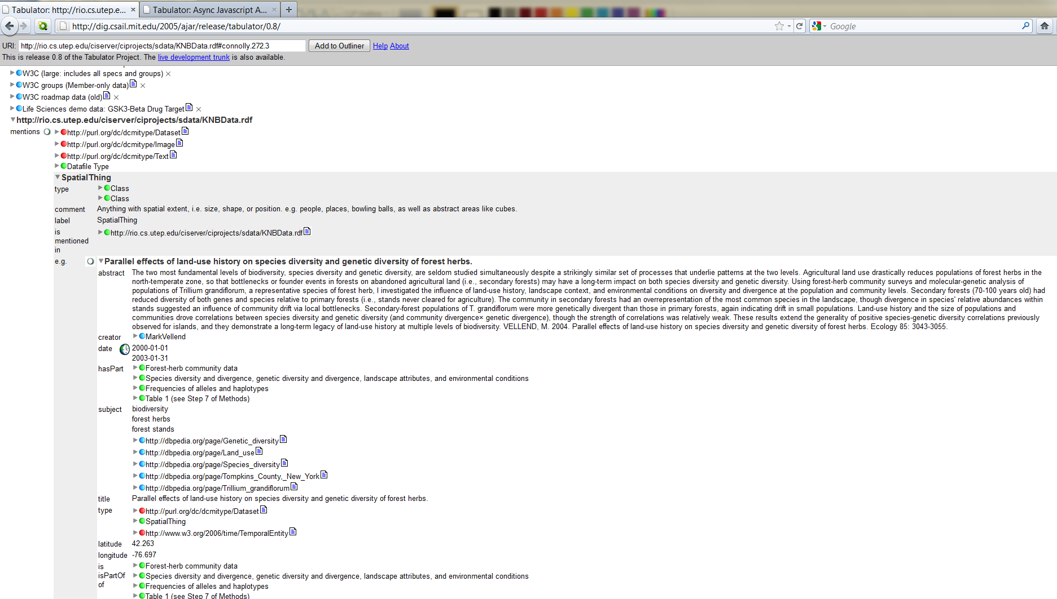
E
X
A
M
P
L
E
O
N
TABULATOR
1) LOADED MY INITIAL DATA : KNB RDF
FOAF
3) LINKS TO RELATED THINGS: e.g., FOAF for author, DBPedia information, what this is made up of hasPart
DBPedia

Slide 17
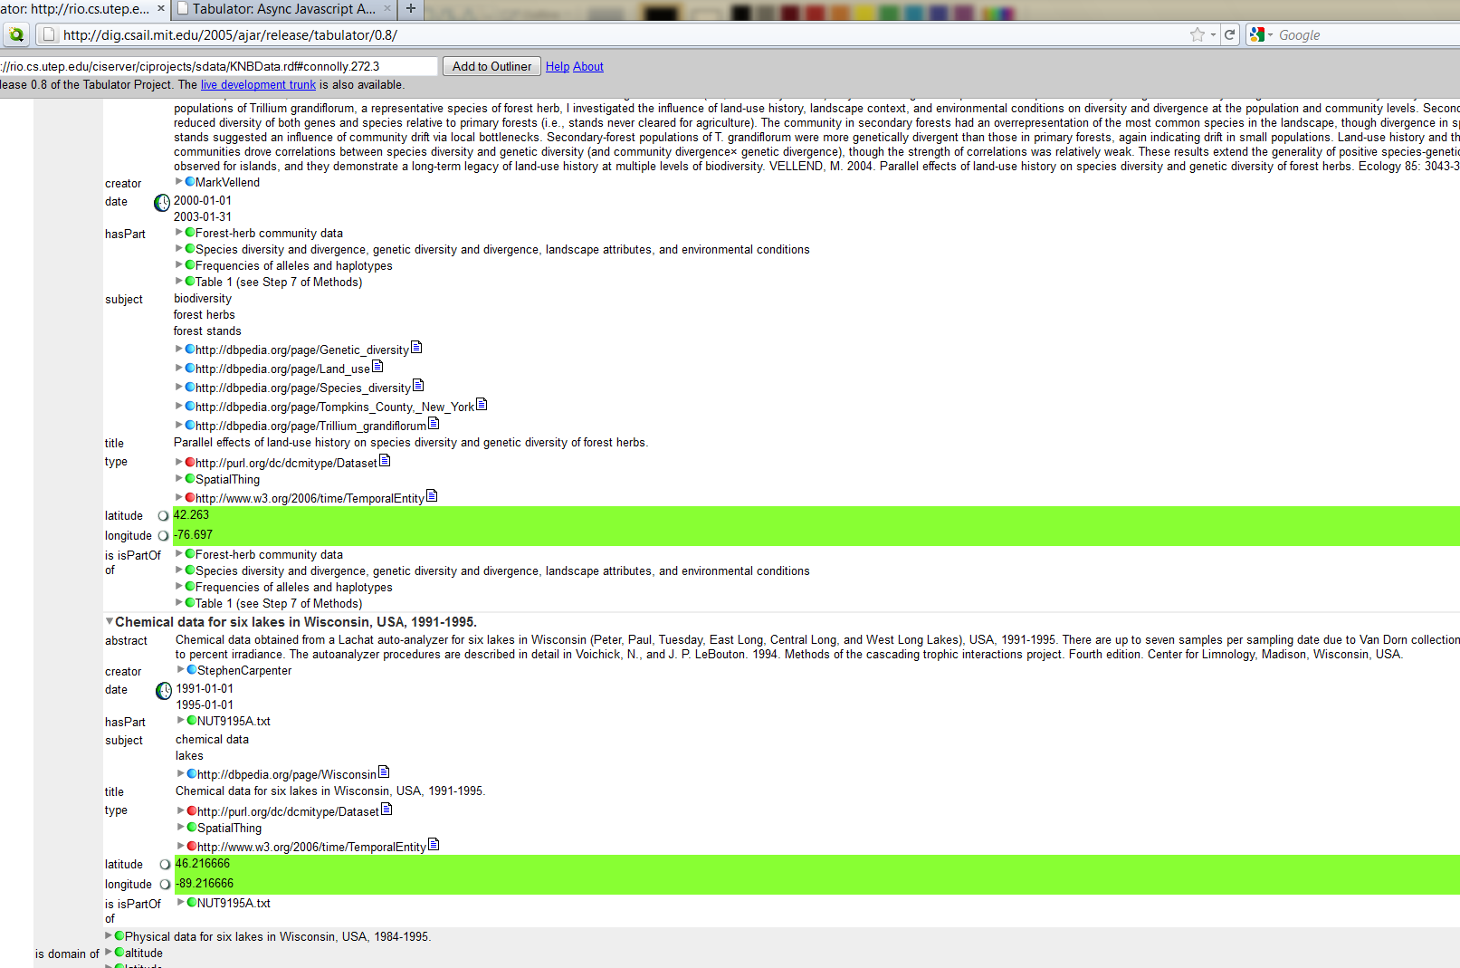
E
X
A
M
P
L
E
O
N
TABULATOR
2) VIEW SOME CONTEXT : Geo Data
Requires more understanding of the RDF data but exhibits the power of RDF browsing
Choose what you want more information on …

Slide 18
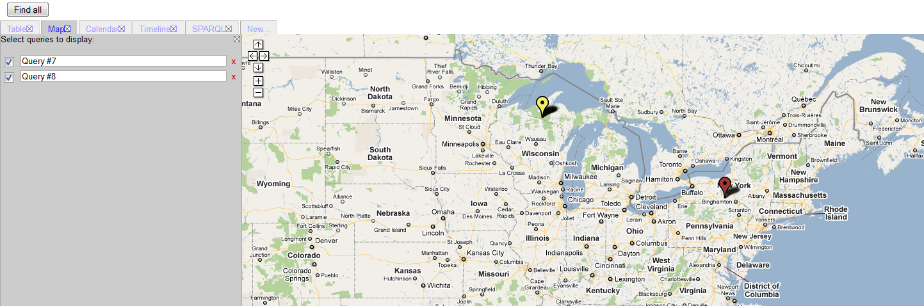
E
X
A
M
P
L
E
O
N
TABULATOR
Choose the context to view it in : a Map
Location data from the 2 datasets
These is are SPARQL queries. They can be turned on and off for a view

Slide 19
LOD Servers and Browsers
Linked Data Server:
Dereference URIs – provide
linkable RDF content for all
URIs
Handle Content Negotiation –
e.g., application/rdf+xml
RDFization for non-RDF
content - build RDFizer to
extract searchable data
Expose RDF using
vocabularies that are useful to
browsers
Expose content with linked
data, including internal URI
links
T
H
E
W
E
B
Browsers
Identify the vocabularies
they understand
Make these known for
RDF publishers
Provide contextual view
for selected vocabularies
Embed with other
browsers or RDF viewers
Firefox w/ODE
Zitgist
Disco
Tabulator

Slide 20
Vocabulary Comments
Not just a matter of choosing your vocabulary.
Need to understand a vocabulary ecosystem that maps the user data to the browser view
Some vocabulary modifications are needed but viewers may not leverage this
e.g. had to define file information for both KNB and Dryad data. DCMI (Dublin-Core Metadata Initiative) not sufficient.

Slide 21
Data Server Comments
The data that I have created is a simulation of what a server would do:
Statically, I create URI results – a server would probably do this dynamically, dereferencing URIs to linkable RDF content
My URI results are only RDF – a server would have to resolve content (content negotiation) to the requested return type
I have specific pages of RDF data – a server would provide a query tool, e.g. in SPARQL – and would return the requested data sets

Slide 22
Browser Comments
Current browsers still not very useful.
Zitgist has only a small number of templates and default view just regurgitates the RDF and links
Tabulator requires that users select content within RDF structures or enter SPARQL
Both allow for extensions
… Browsers are key to understanding linked data so there will be a need for viewer/browser harmony in leveraging linked data

Slide 23
Tabulator: Data Integration
The power of having access to multiple sets of data – can compare data
In one view
In a specific context

Slide 24
Next Step: Use Case 2
By loading related data from LOD
Injecting relations between DataONE and LOD content
Querying using a modified browser technology
Should show Use Case 2 for LOD4DataONE

Slide 25
Questions
Send them to aida.gandara@sbcglobal.net

